Slide 1

Community Impact & Organizational Overview

Slide 2
Professional Presentation Outline
Organization Overview
Mission Statement
Vision Statement
Youth Impact
Community & Economic Impact
Butterfly Club
Volunteer Opportunities
Budget Overview
Future Goals

Slide 3
Organization Overview
The Lillie Mae Parson Performing Arts Center (LMP) is a Clearwater-based nonprofit organization focused on empowering youth through arts education, mentorship, leadership development, community engagement, and safe creative spaces.
Programs | Focus
Dance & Music | Creative Expression
Drama & Theater | Confidence Building
Writing & Arts | Communication Skills
Mentorship | Leadership Development

Slide 4
Mission Statement
The Lillie Mae Parson Performing Arts Center aims to value arts education as a critical component of academic success that helps build confidence, empathy, creativity, and social connectivity.

Slide 5
Vision Statement
LMP envisions a future where youth have access to safe, empowering, and creative spaces that inspire leadership, healing, and career opportunities.

Slide 6
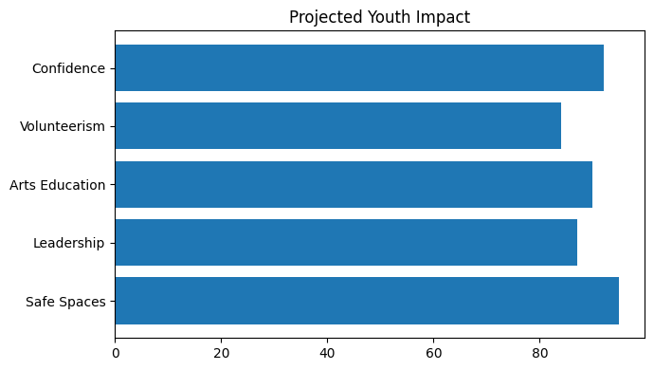
Projected Youth Impact
Impact Area | Projected Outcome
Safe Spaces | Positive Youth Engagement
Leadership | Mentorship Growth
Arts Education | Creative Development

Slide 7
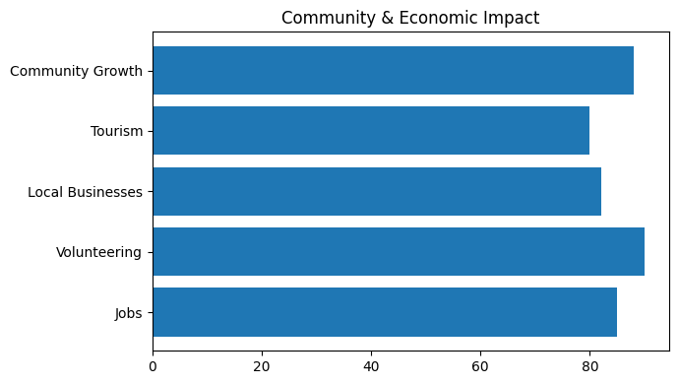
Community & Economic Impact

Slide 8
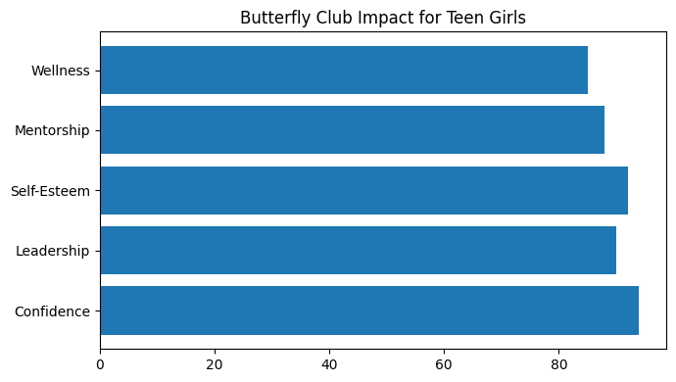
Butterfly Club for Teen Girls
The Butterfly Club is designed to help girls grow into confident, empowered, and purpose-driven young women.

Slide 9
Volunteer & Leadership Opportunities
Opportunity | Community Benefit
Event Planning | Leadership Experience
Mentorship | Youth Guidance
Community Outreach | Public Engagement
Internships | Workforce Development

Slide 10
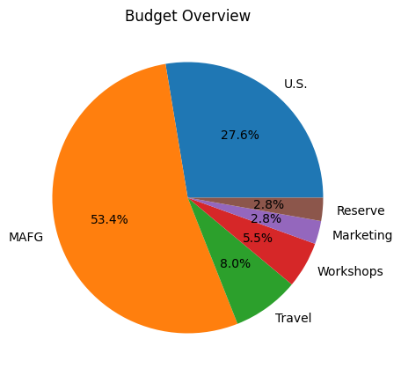
Budget Overview
Category | Amount
U.S. Operations | $25,000
MAFG Support | $48,300
Travel | $7,200
Workshops | $5,000
Marketing | $2,500
Reserve | $2,500

Slide 11
Future Goals
Opening a permanent arts facility
Expanding after-school programming
Increasing youth participation
Creating workforce development opportunities
Hosting cultural arts events

Slide 12
Together We Can Build Stronger Communities Through the Arts

